Slide 1


FLIXIFY
FLIXIFY
YOUR FUN, YOUR WAY
GROUP -20
Group Members
Kashyap Gajera - 202201324
Harshit Prajapati - 202201500

Slide 2



Project Overview
FLIXIFY: THE FUTURE OF STREAMING
Flixify is an innovative entertainment platform designed to redefine the streaming experience by combining the best elements of traditional video-on-demand services with cutting-edge, user-centric features. Inspired by industry leaders like Netflix, Flixify sets itself apart with a unique suite of offerings tailored to modern viewers’ preferences.
KEY FEATURES INCLUDE
Watch Party with Video
A social viewing experience that allows users to watch content together in real-time, complete with integrated video chat for seamless interaction with friends and family, no matter the distance.
Interactive Movies with Decision-Making
Making Decision
An immersive storytelling format where viewers actively shape the narrative by making choices that influence the outcome, blending cinema with gamified engagement.
Short Movie Reels Series
Bite-sized, episodic content designed for quick consumption, catering to users seeking high-quality entertainment in a fast-paced world.
AI Video Summary

Slide 3


Project Overview
AI Video Recap
AI-driven tool that crafts video recaps of previous seasons of shows, offering users a quick way to catch up without revealing key plot details or wasting time.
Mood-Based Content Selection
Enjoy movies or shows that match your current mood, enhancing your overall experience and bringing more joy.
Flixify aims to establish a vibrant, community-oriented, and personalized entertainment platform that not only provides high-quality content but also encourages connection, creativity, and convenience. By utilizing cutting-edge technology and a profound understanding of audience preferences, Flixify is set to emerge as a next-generation leader in the streaming sector.

Slide 4
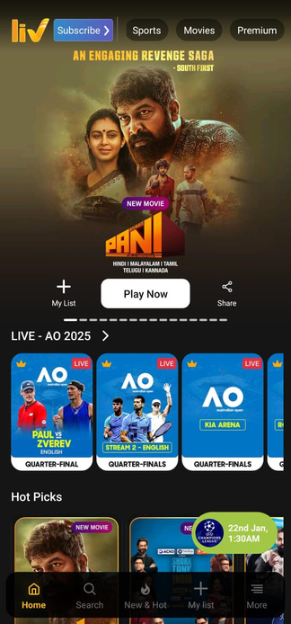
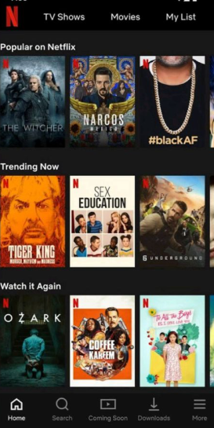
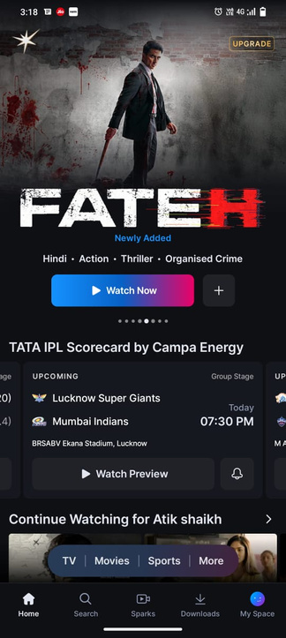
Competitor Analysis
Sony Liv
Netflix
JioHotstar
The small entertainment category icons on the
Sony LIV homepage are challenging to interact
with
Netflix offers a great selection of movies, but it lacks features like watch parties or short films.
JioHotstar offers a pleasant experience; however, it lacks features such as AI video summaries and interactive movie experiences.

Slide 5

Competitive analysis
STRENGTHS
Offers a wide range of TV shows, movies, live sports, and originals in multiple languages.
Strong sports content including cricket, football, and WWE gives it a competitive edge.
Visually appealing and easy-to-navigate layout enhances user experience.
Recommends content based on user behavior and preferences.
Allows offline viewing, which is useful for mobile users.
\
WEAKNESSES
Some premium content still includes ads, frustrating paying users.
Limited content filters make it harder to find specific genres or types.
Buffering and crashing issues reported on some devices.
No community or social features for users to engage.
Not fully optimized for users with disabilities.

Slide 6

User Survey
Questionnaire
Age
Which entertainment app do you use mostly?
How often do you use entertainment apps like Netflix, amazon prime or Hotstar?
What type of entertainment content are you most interested in?
What type of features for you value most in entertainment app?
How do you prefer to browse content in app?
How often do you purchase subscriptions for entertainment apps?
What type of navigation do you prefer in an entertainment app?
What do you dislike most about entertainment app?

Slide 7
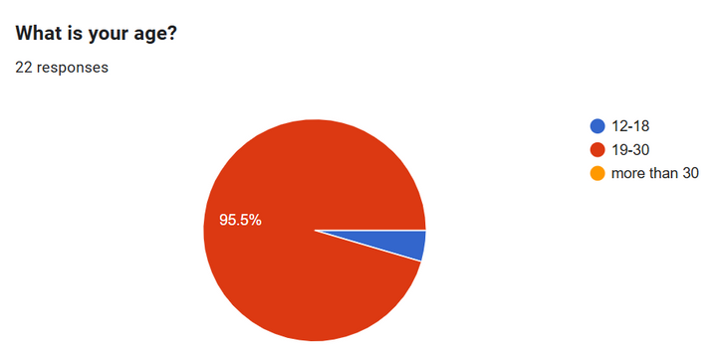
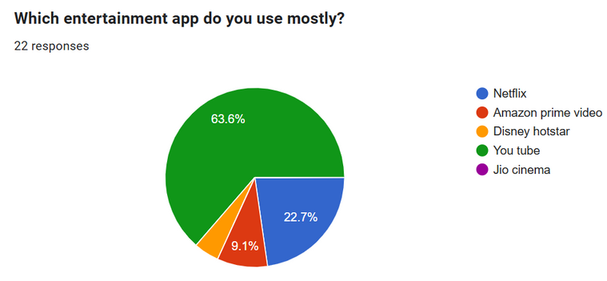
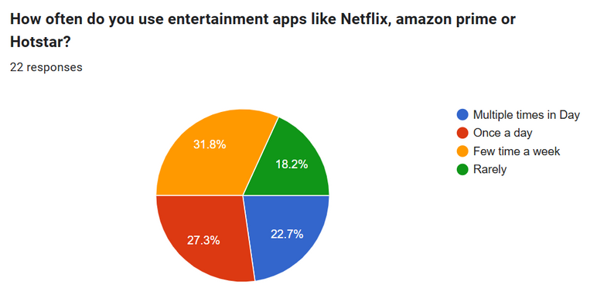
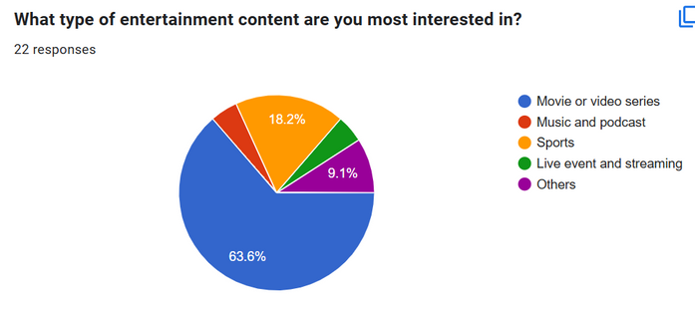
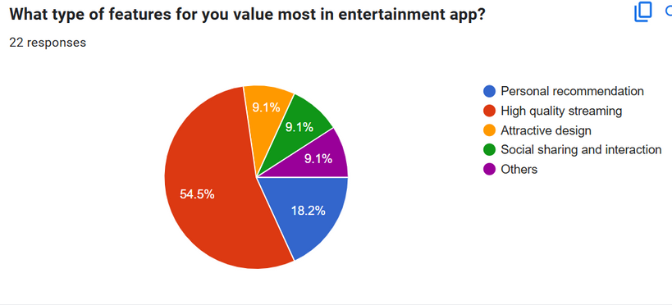
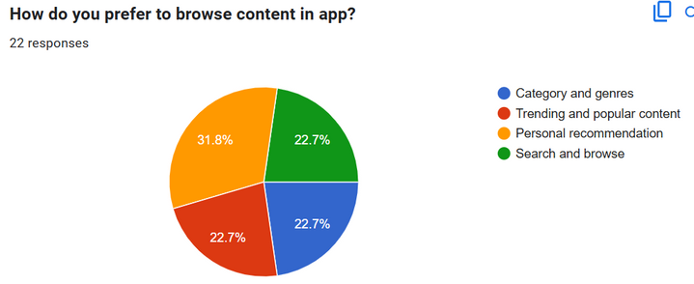
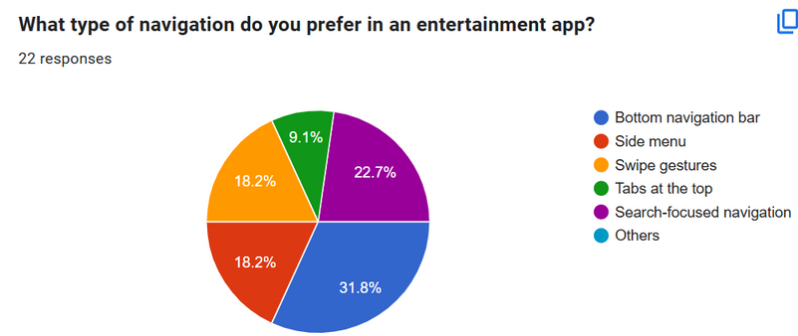
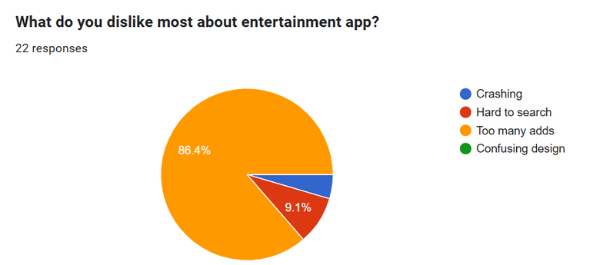
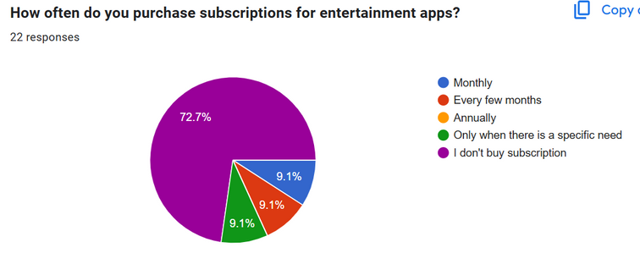
Survey Results
>

Slide 8
Survey Results
The survey results indicate that the majority of respondents (95.5%) are aged 19-30 and primarily use YouTube (63.6%) as their entertainment app. Most users prefer video/movie content (63.6%) and highly value high-quality streaming (54.5%).
The biggest dissatisfaction with entertainment apps is excessive ads (86.4%), while navigation preference is split between bottom navigation bars (31.8%) and search-focused options (22.7%).

Slide 9



Male User Persona
DESCRIPTION
Jenil is a techsavvy professional who enjoys watching movies and sports in his free time.
He prefers highquality streaming and often uses entertainment apps to unwind after work.
He is not a frequent subscriber but occasionally purchases subscriptions when there’s a specific show or sports event he wants to watch.
GOALS
Wants a seamless streaming experience with minimal interruptions
Prefers apps that offer highquality video and easy navigation
ENTERTAINMENT PREFERENCE
Most Used App : YouTube
Frequency of Use : Few times a week
Preferred Content : Sports and Movies/Video Series
Favorite Features: High-quality streaming, Trending and popular content
Browsing Preference: Search and browse, Trending content
Subscription Behavior: Only purchases subscriptions when there’s a specific need
Jenil Goswami
Age 25
FRUSTRATIONS
Dislikes too many ads in the app
Finds Subscription costly
Software Engineer
Anand, Gujarat
HOBBIES AND INTERESTS
Watching Movies
Travelling
Playing sports
MOTIVATIONS
Exploration & Discovery
cultural & Trending event

Slide 10

Female User Persona
DESCRIPTION
Khushi is a busy professional who enjoys watching movies and TV series in her downtime. She values personalized recommendations and often uses entertainment apps to relax after a long day. She prefers apps that are easy to navigate and offer a wide variety of content.
GOALS
Wants an app that offers personalized content suggestions
Prefers apps with a clean and attractive design
ENTERTAINMENT PREFERENCE
Most Used App: Netflix
Frequency of Use: Once a day
Preferred Content: Movies/Video Series
Favorite Features: Personal recommendations, High-quality streaming
Browsing Preference: Personal recommendations, Category and genres
Subscription Behavior: Subscribes monthly
Khushi Mehta
Age 28
FRUSTRATIONS
Dislikes too many ads in the app
Finds it hard to search for specific content sometimes
Marketing Manager
Surat, Gujarat
HOBBIES AND INTERESTS
Watching Dramas & comedies
Story Reading
Podcasts
Cultural Events
MOTIVATIONS
Relaxation & Escape
Stay Culturally Updated
Social Connection

Slide 11
Empathy Map
seamless, high-quality streaming.
Interactive movies sound exciting.
recommendations that match mood.
Ads shouldn't ruin the experience
watching movies with friends in real time
Watching short series is less time consuming
Says
Thinks
Does
Feels
Tries AI recaps and mood-based picks.
Excited by new, fun features
Watches Short series
Interactive movies are fun
Joins watch Together.
Annoyed by too many ads

Slide 12
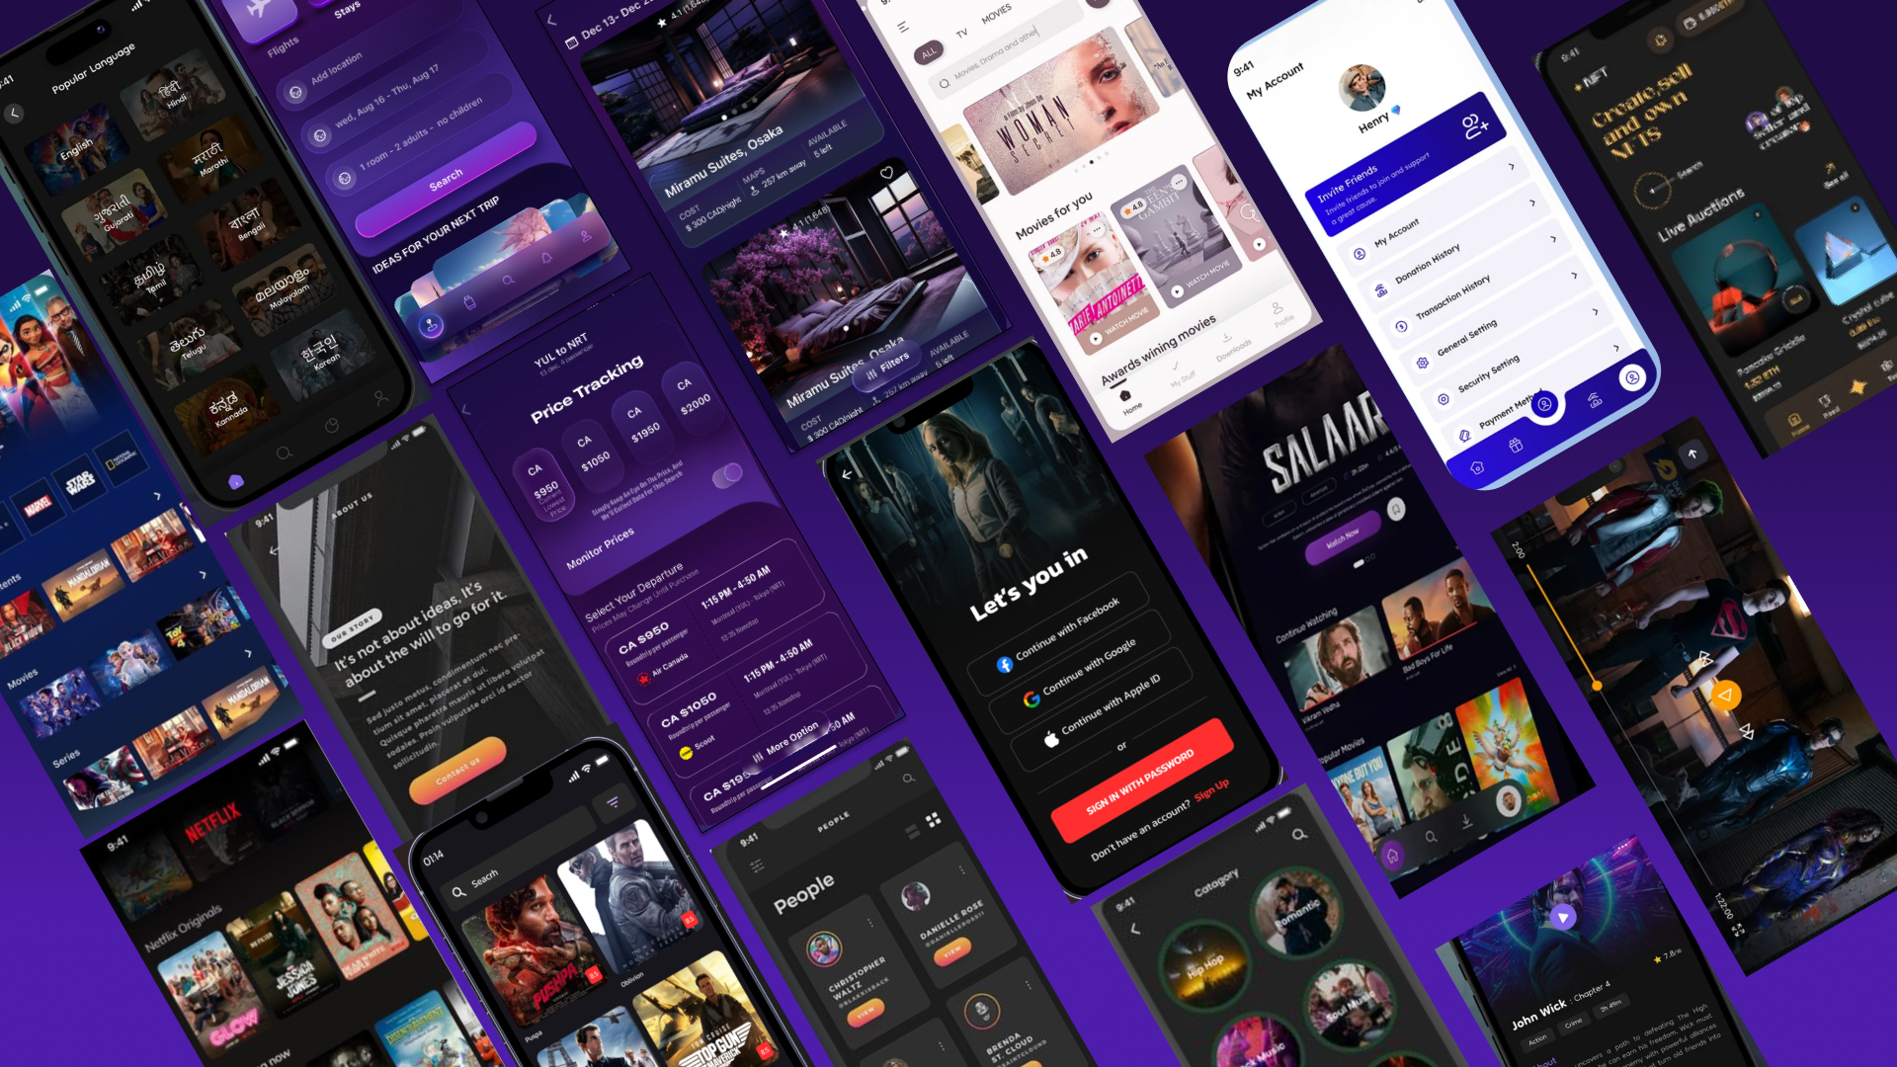
Mood Board

Slide 13
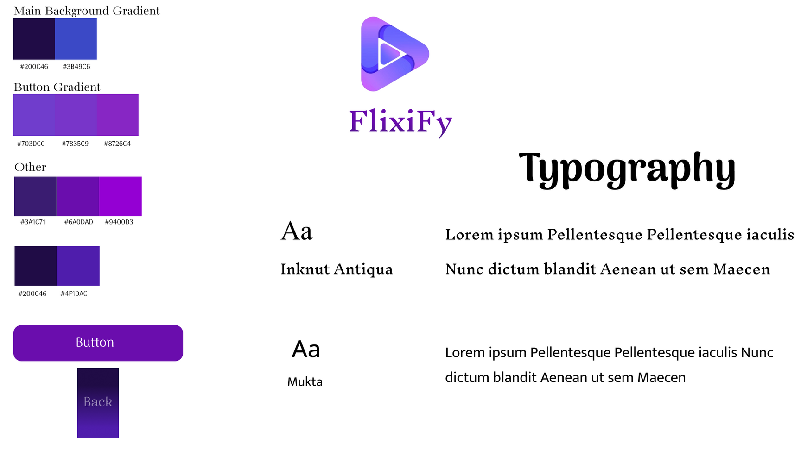
Theme & typography

Slide 14
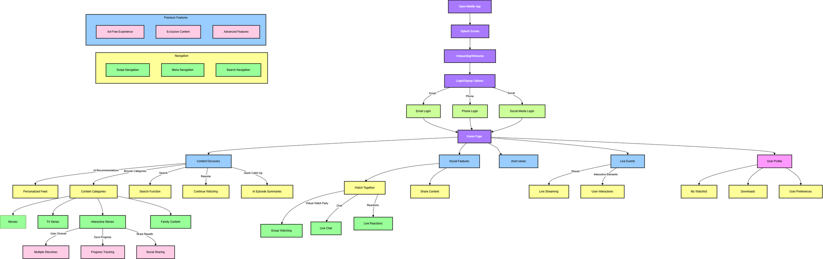
Information Architecture

Slide 15
Design Statement
Young adults (aged 19–30) seek an entertainment platform that goes beyond traditional streaming services. They crave an engaging and socially interactive experience that blends high-quality content with modern features like watch parties with video chat, short movie reels, and AI-driven content recommendations.
Users often feel disconnected when watching alone, face choice fatigue due to overwhelming content, and want more immersive and shareable experiences. Flixify aims to solve these problems by offering personalized, interactive, and community-driven entertainment in a simple, intuitive, and visually appealing interface.

Slide 16
LOW FIDELITY
LOW FIDELITY
WIREFRAME

Slide 17

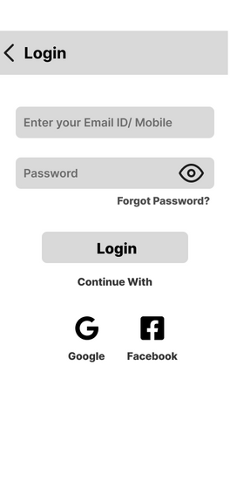
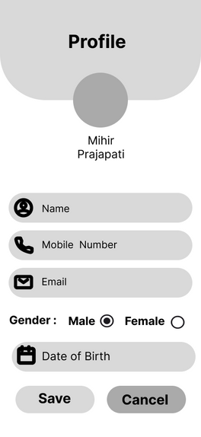

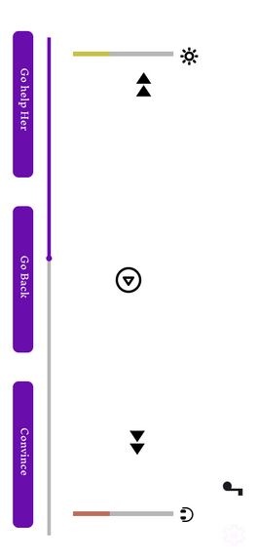
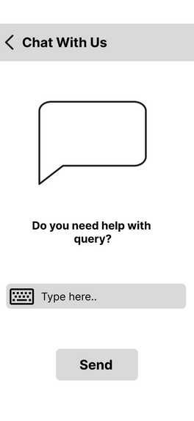
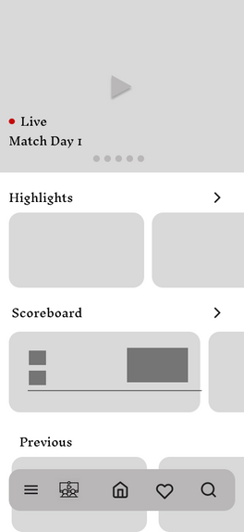
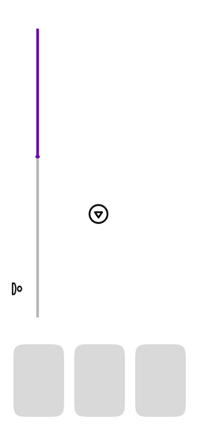

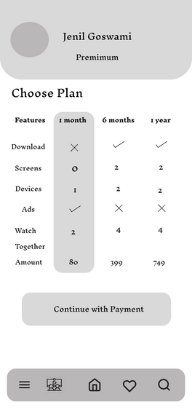
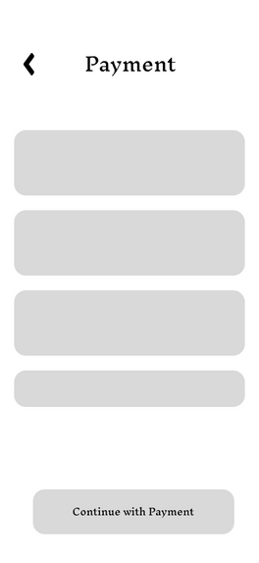
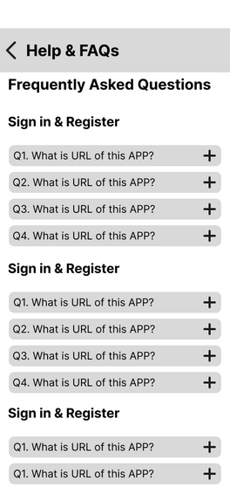



LOW FIDELITY
>

Slide 18
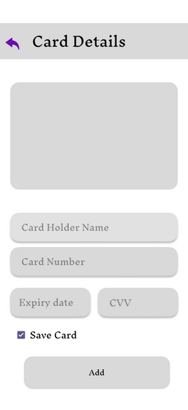
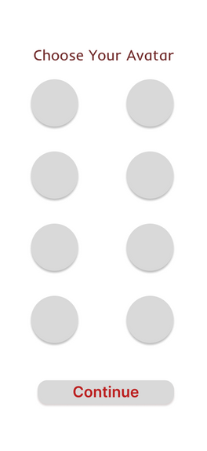
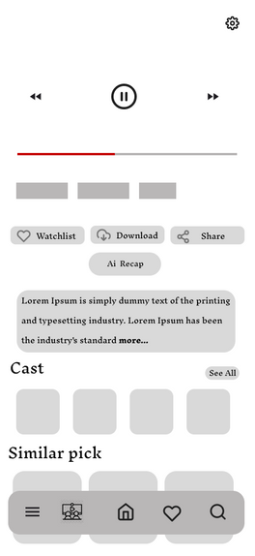



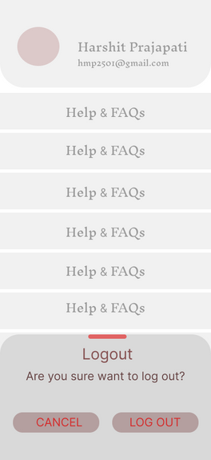

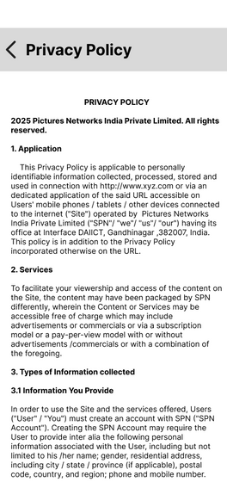
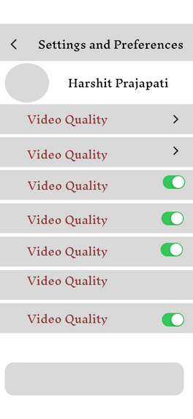
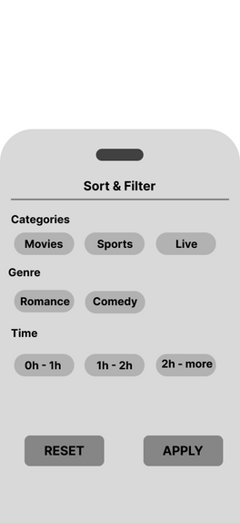
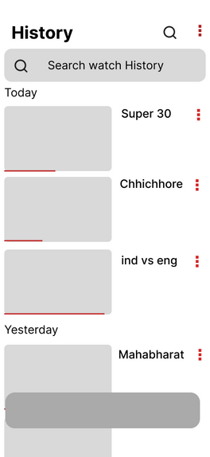

LOW FIDELITY
>

Slide 19
HIGH FIDELITY
HIGH FIDELITY
WIREFRAME

Slide 20
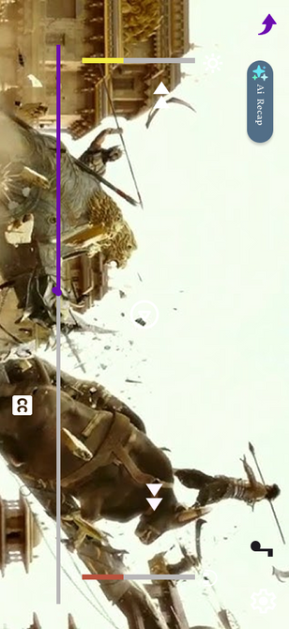
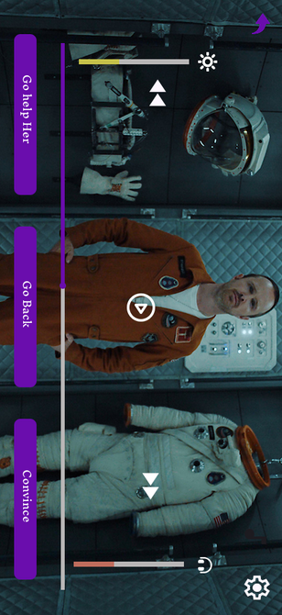
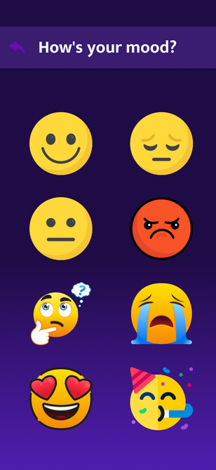

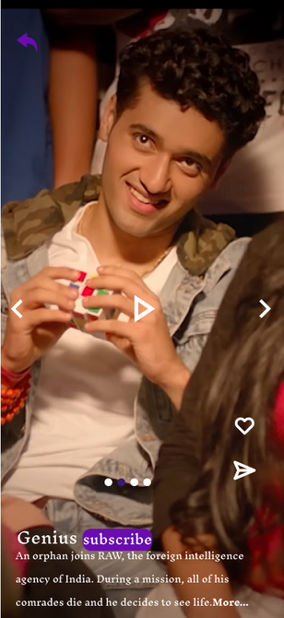
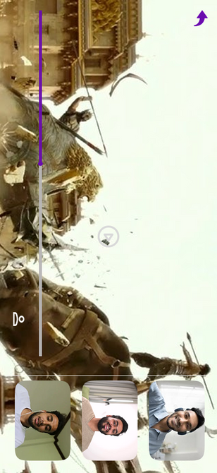
Main features
Ai Video Recap
Interactive Movies
Mood Preferred Content
Watch Movies With Your Friends or Random Person with similar Interest
Short Series

Slide 21



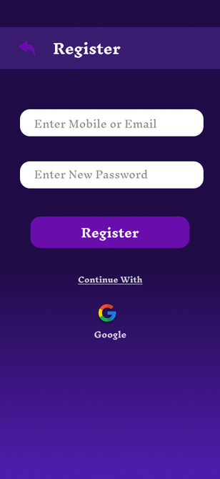
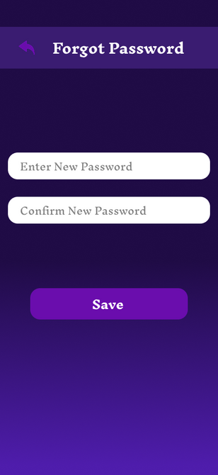

LOGIN
Users will be asked to
put there credentials
to join the app
Forgot Password
Login success
Onboarding
App logo and name
Login with Google
OTP
>

Slide 22
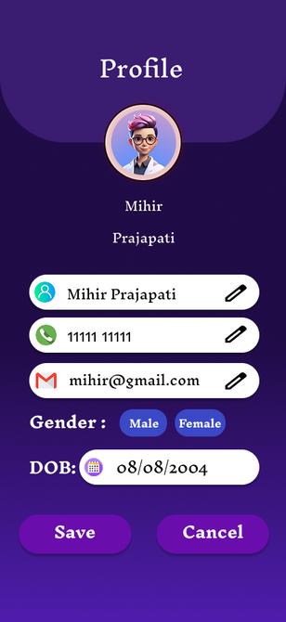
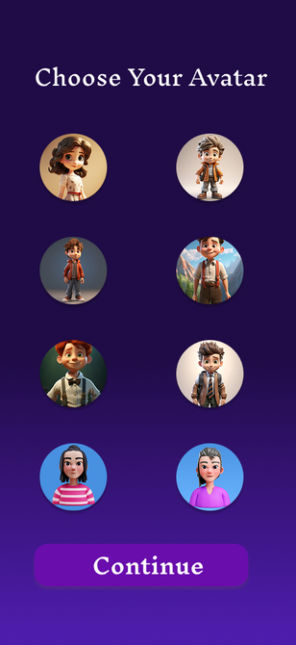
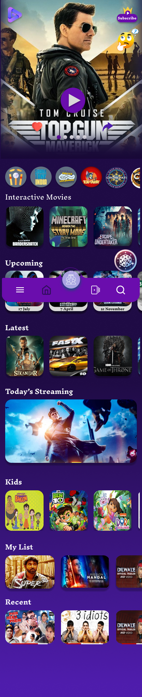

Going to Homepage
Choose account
Homepage
User profile
Avatars

Slide 23
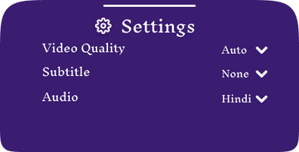
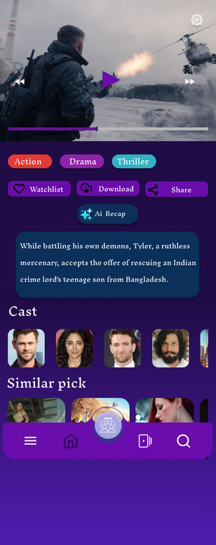

Homepage
Homepage
Video Streaming
Subscription Icon
Mood Play
User Preferred Settings Options
Play button
Wishlist
Share Icon
AI summary
Live Event
Random pick
Menu bar
search Icon
Watch together
Varity of Sharing Options
short series icon

Slide 24
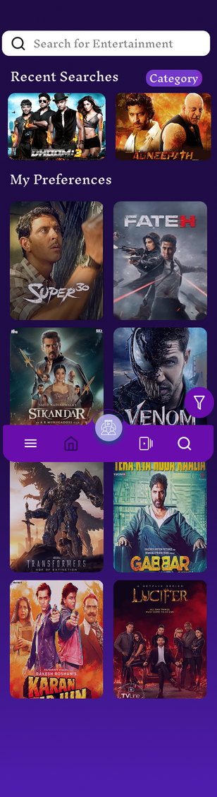
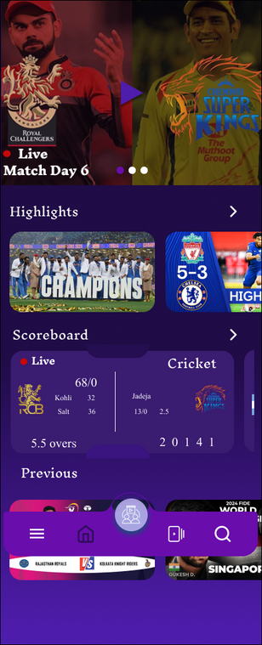
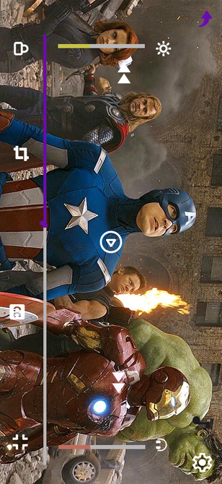
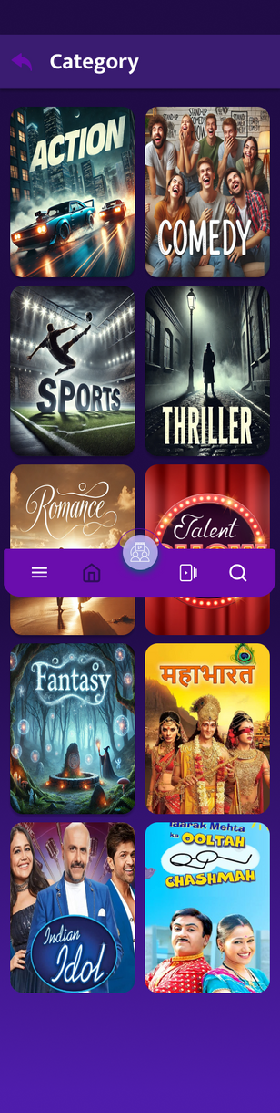
HIGH FIDELITY
Find Your Category
Playback Screen
Live Score Board
Search Your Favorite Shows
Watch Sports

Slide 25
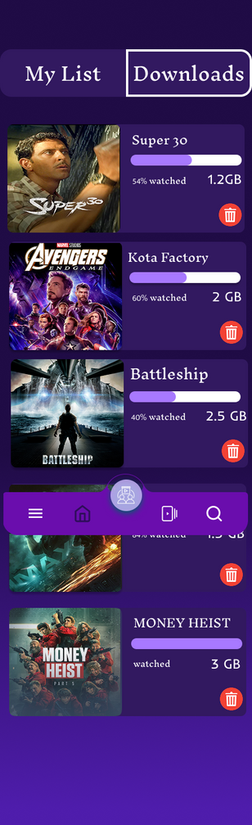
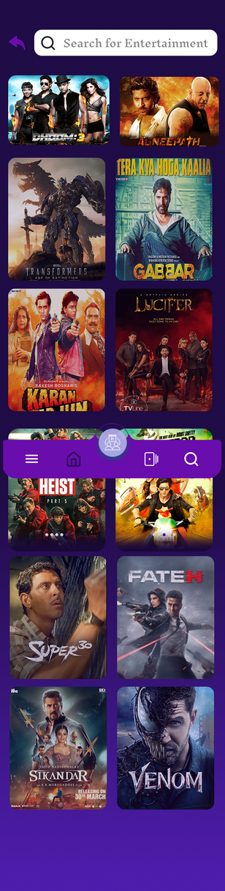

HIGH FIDELITY
Save to Wishlist
Manage Downloads
Varity of Show List

Slide 26






Subscription
Pay with Card & save cards for future access
Different Payment Methods
Payment Confirmation
Get access to More Features
With Subscription
Pay with Card & save cards for future access
Pay With Wallet

Slide 27






HIGH FIDELITY
Control Of content with Parental Control
Chat With us For any Queries
Apply coupons for Discount offers
User Settings & Preferences
Settings

Slide 28


